Slide 1
Establishing a Just, Learning Culture
Barriers and Challenges
Puna Poudel

Slide 2
Introduction
A just culture promotes fairness, learning, and accountability.
Encourages open reporting of mistakes without fear of punishment.
This presentation explores key barriers to implementing a just culture and strategies to overcome them.

Slide 3
Barrier 1 – Blame Culture
Assigning personal blame discourages open reporting.
Employees fear punishment, leading to underreporting of incidents.
Organizations miss opportunities to identify systemic issues and make improvements.
(Source: justculture.hqca.ca)

Slide 4
Barrier 2 – Outcome Bias
Judging actions based on the outcome rather than intent.
Severe consequences may lead to harsher judgments.
Discourages individuals from reporting errors.
(Source: humanisticsystems.com)

Slide 5
Barrier 3 – Lack of Transparency
Unclear reporting mechanisms hinder openness.
Employees are unsure how reported errors will be used.
Fear of repercussions prevents proactive reporting.
(Source: justculture.hqca.ca)

Slide 6
Barrier 4 – Unrealistic Expectations of Perfection
Pressure to maintain flawless performance discourages learning.
Employees may feel ashamed or reluctant to report mistakes.
This mindset inhibits continuous improvement.
(Source: justculture.healthcare)

Slide 7
Barrier 5 – Regulatory and Legal Pressures
Fear of litigation or regulatory punishment discourages open reporting.
Focus on individual blame rather than systemic improvements.
Prevents a culture of transparency and learning.
(Source: justculture.healthcare)

Slide 8
Overcoming Barriers
Leadership Commitment: Foster a culture that values learning over punishment.
Clear Reporting Systems: Establish anonymous and nonpunitive reporting mechanisms.
Consistent Policies: Standardize the approach to handling incidents.
Education and Training: Teach employees the importance of a just culture.
(Source: humanisticsystems.com)

Slide 9
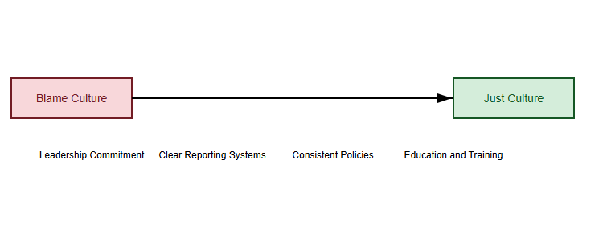
Visual Representation

Slide 10
Conclusion
A just culture enhances learning, accountability, and safety.
Addressing barriers fosters trust and transparency.
Implementing structured strategies ensures sustainability and effectiveness.

Slide 11
References
Humanistic Systems. (2023). Why Is It Just So Difficult? Barriers to 'Just Culture' in the Real World. Retrieved from https://humanisticsystems.com/2023/10/18/whyisitjustsodifficultbarrierstojustculture/
Health Quality Council of Alberta (HQCA). (n.d.). Overcoming Barriers to a Just Culture. Retrieved from https://justculture.hqca.ca/overcomingbarrierstoajustculture/
Just Culture Healthcare. (n.d.). Defining Just Culture. Retrieved from https://www.justculture.healthcare/definingjustculture/

